Slide 1


HOTEL MANAGEMENT SYSTEM

Slide 2
Members:
Ayush Kumar
Debjit Basak
Nabanita Sarkar
Satyam Singh
Sayon Gupta
Ujjwal Barman

Slide 3
Table of Contents
Acknowledgement.
Project Objective.
Requirement Specification.
Screenshots
Future Scope of Improvements.
Conclusion.

Slide 4
1. Acknowledgement
I take this opportunity to express my profound gratitude and deep regards to my faculty Dayamay Halder for his exemplary guidance, monitoring and constant encouragement throughout the course of this project. The blessing, help and guidance given by him/her time to time shall carry me a long way in the journey of life on which I am about to embark.
I am obliged to my project team members for the valuable information provided by them in their respective fields. I am grateful for their cooperation during the period of my assignment.

Slide 5
2. Project Objective.
During the past several decades’ personnel function has been transformed from a relatively obscure record keeping staff to central and top level management function. There are many factors that have influenced this transformation as most important resources.
Few activities to be performed in this project :--
1. Room activities.
2. Admission of a New Customer.
3. Assign a room according to customer’s demand.
4. Checkout and releasing the room.
5. Updating the customers details.
6. Finally compute the bill.

Slide 6
3. Requirement Specification.
HARDWARE-
1. 1 T.B Hard disk
2. 8 GB DDR4 RAM
3. 64bit Operating System.
SOFTWARE-
1. Eclipse Mars version .2 and above
2. JDK v1.8.0
3. Windows 7 and above

Slide 7
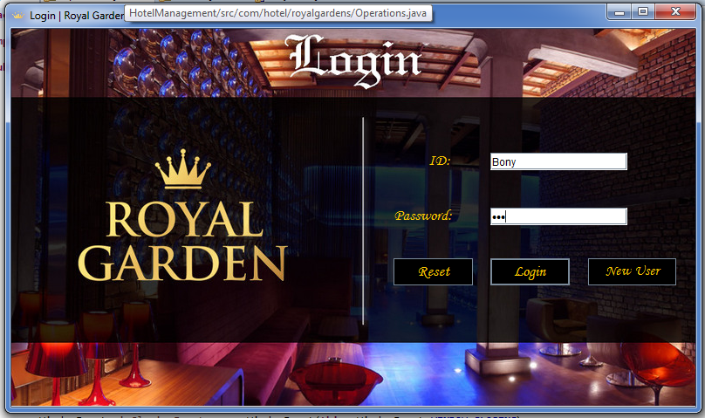
4. ScreenShots
4.1 Login Page

Slide 8
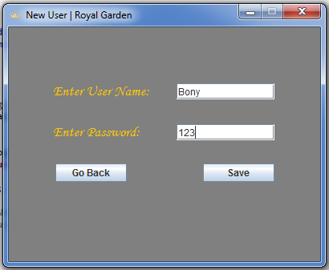
4.2 New User Page

Slide 9
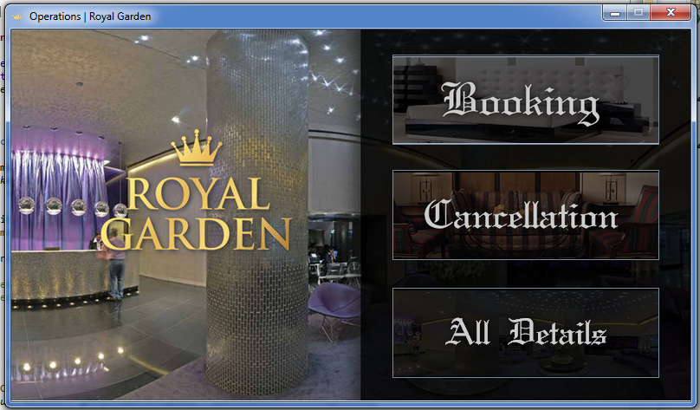
4.3 Operations Page

Slide 10
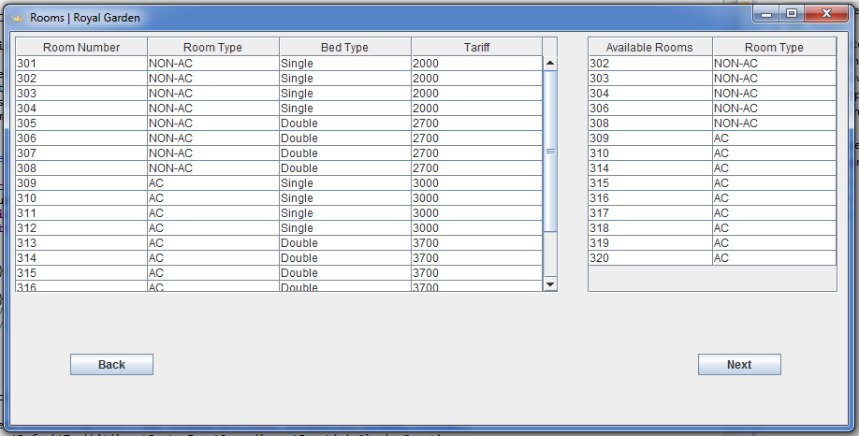
4.4 Room Booking Page

Slide 11
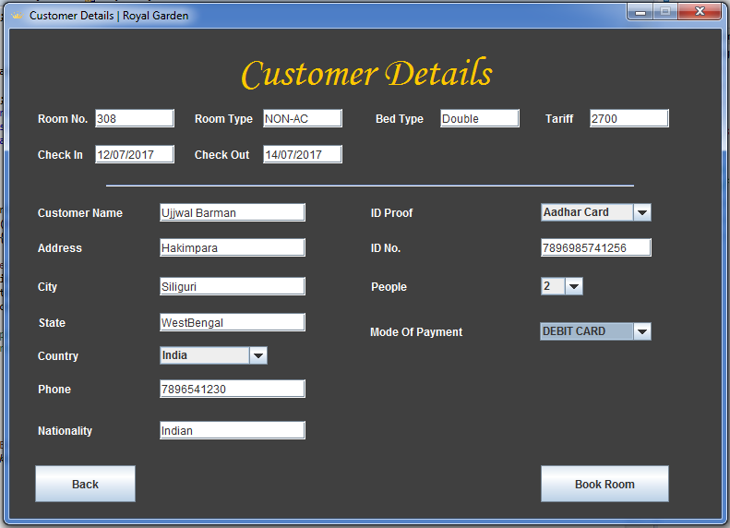
4.5 Customer Details Page

Slide 12
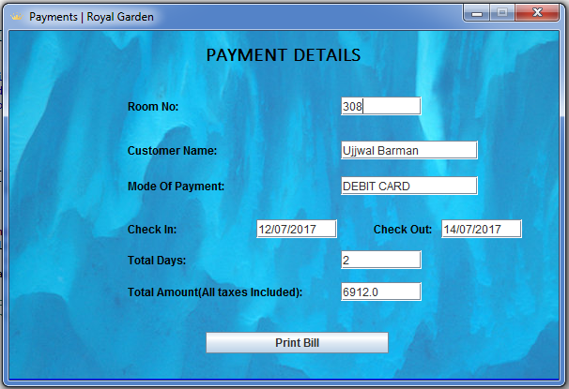
4.6 Payment Page

Slide 13
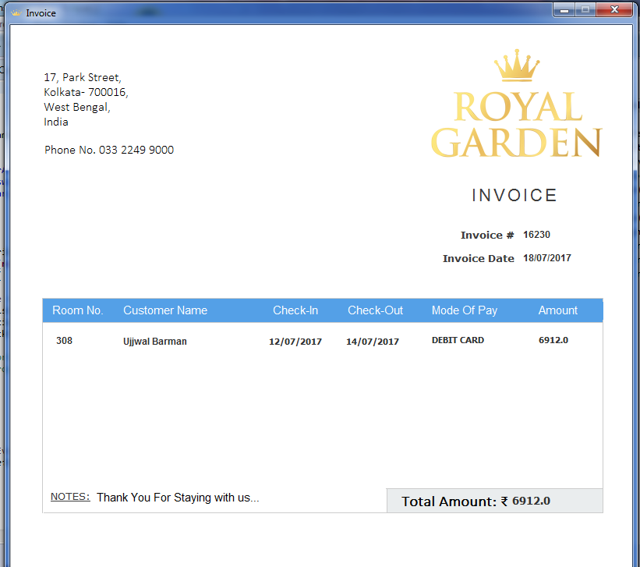
4.7 Invoice Page

Slide 14
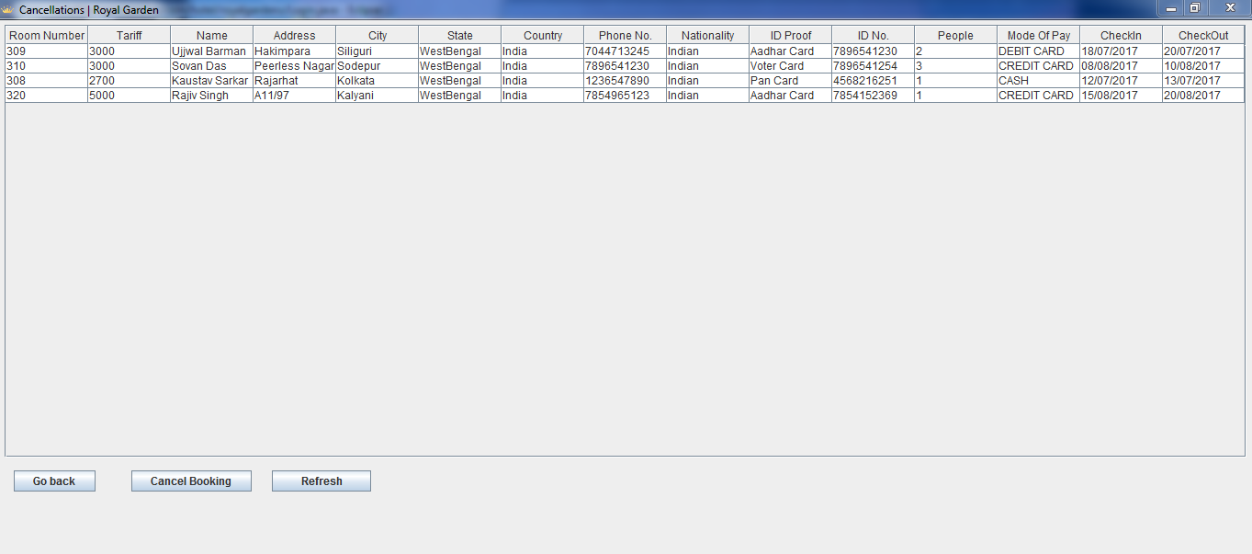
4.8 Cancellation Page

Slide 15
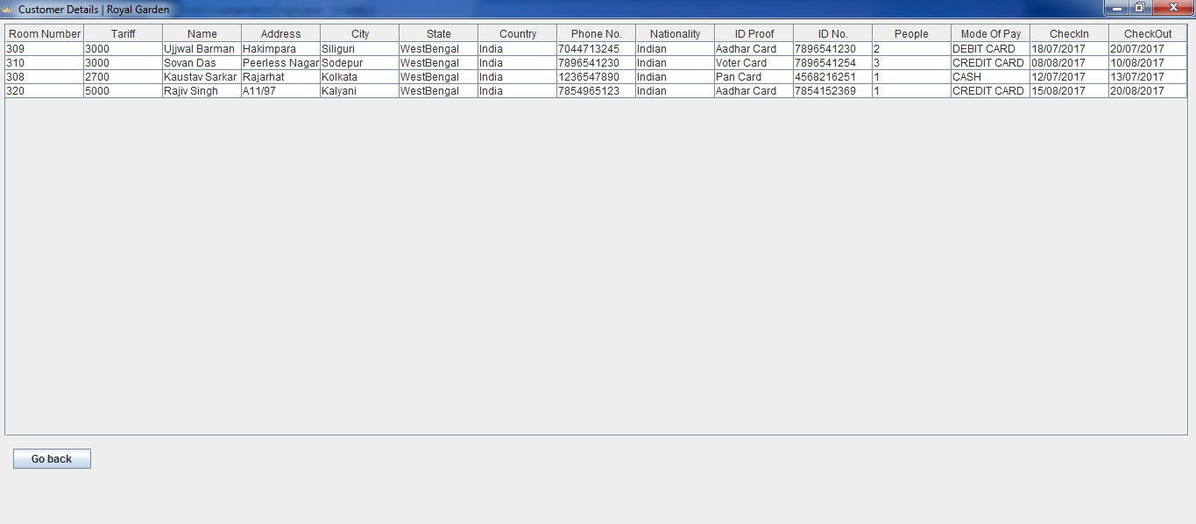
4.9 All Details Page

Slide 16
5.Future Scope of Improvements.
In future our software could be further enhanced by providing our customer with the facility of booking room more than one time with his/her customer_id. After that, it would not necessary to submit his/her detail again and again.
Apart from that in future our software can also be used for hotel that provide both lodging and fooding facilities, in such case our software would also keep a record of food supplements and recruited staff in our database. In other words our software would provide staff management as well as restaurant management.
The inclusion of these features would definitely make our software highly demanding and would be a grand success in practical field.

Slide 17
6.Conclusion.
It has been a matter of immense pleasure, honor and challenge to have this opportunity to take up this project and complete it successfully.
While developing this project I have learnt a lot about hotel management, I have also learnt how to make it user friendly(easy to use and handle) by hiding the complicated parts of it from the users.
During the development process I studied carefully and understood the criteria for making a software more demanding, I also realized the importance of maintaining a minimal margin for error.

Slide 18
THANK YOU

